Slide 1

DataWave
Building the infrastructure for the data economy

Slide 2
01
Core Vision

Slide 3

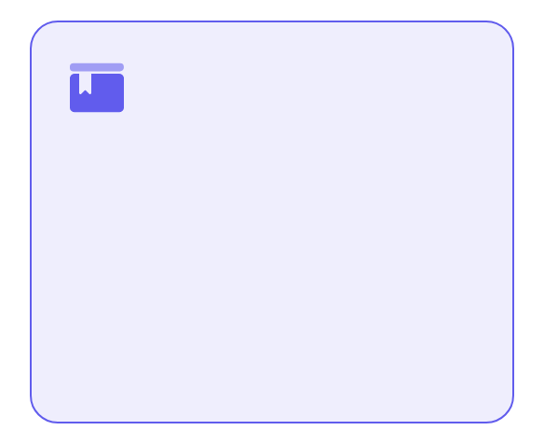
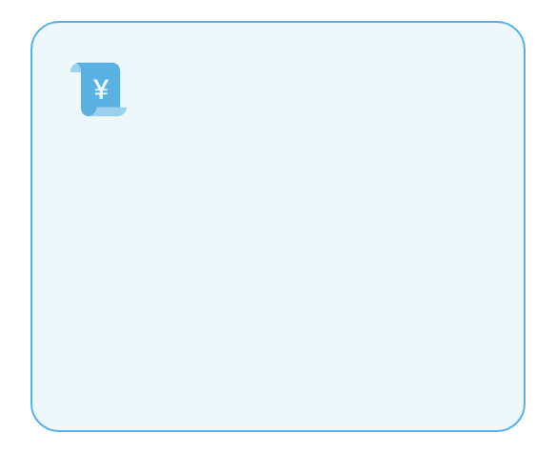
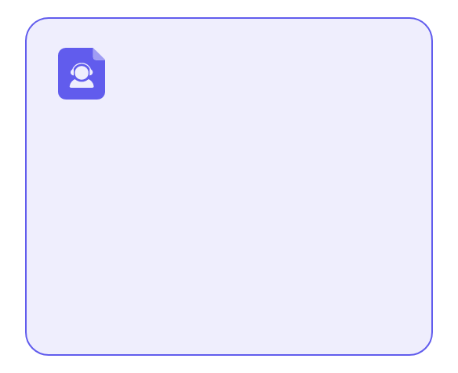
Convert extracted data into tradable economic assets
Data is an asset
breakup of monopoly
Tradable
Redefine the value of data and let users control the ownership and revenue of their data.
To break free from the platforms centralized control over data and achieve decentralized value circulation.
Enable data authorization and subscription through the protocol layer to generate continuous revenue from data flow.

Slide 4

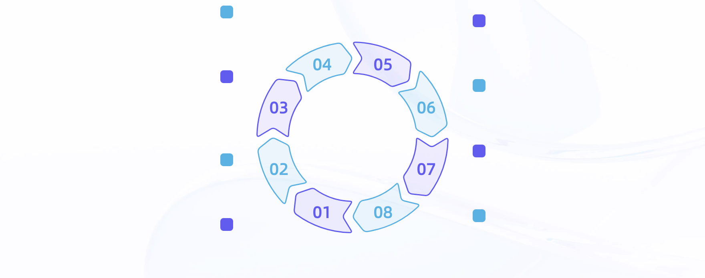
Building a Data Value Circulation Network in the Web3 Era
Break data silos
Subscription-based dividends
Eliminate data barriers between platforms, promote cross-platform data sharing and collaboration, and unlock the potential of data.
The subscription-based model with profit-sharing mechanism provides users with continuous passive income incentives.
Sui Chain Flow
Incentivizing data contributions
The Sui blockchain enables efficient and cost-effective data value transfer, accelerating transactions while reducing costs.
Economic incentives are used to encourage users to contribute data actively and enhance the data richness and activity of the network.
Decentralized storage
data assetization
The decentralized infrastructure is built on Walrus and Seal to ensure secure data storage and trustless operation.
Quantify personal data into tradable digital assets to enhance the economic value and liquidity of data.
Privacy is self-controlled and under our own management.
Protocol layer rights
Protect users privacy control over personal data and create a trustworthy and transparent data usage environment.
The ownership of personal data is confirmed at the protocol layer to clarify the ownership of data and lay the foundation for subsequent assetization.

Slide 5
User-Centric Data Sovereignty Infrastructure
01
02
03
Data is returned to the user.
Control yourself
Sustainable revenue
Ensure that the ownership of personal data returns to users and break the monopoly of platforms.
The technology of encryption and selective disclosure is used to realize the autonomous permission management.
Build a subscription-based sustainable dividend mechanism to unlock the long-term value of data.

Slide 6
02
Problem Insight

Slide 7
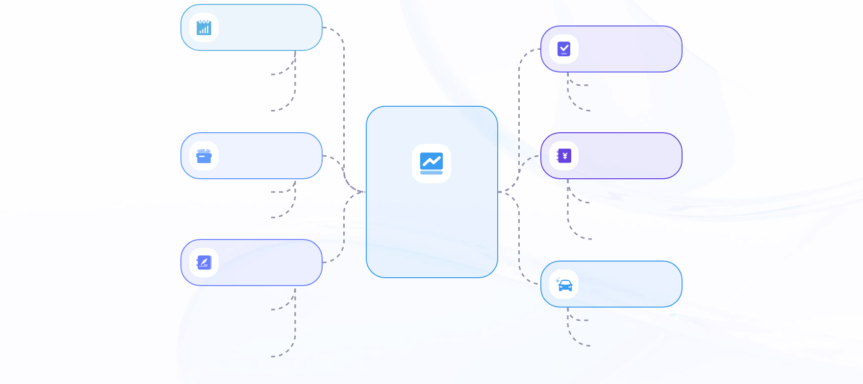
The data is currently monopolized by the platform, and users cannot get the benefits they deserve
data monopoly
insufficient incentive
Tech giants control vast amounts of user data, creating information barriers.
The lack of an effective reward mechanism reduces users willingness to contribute.
Centralized data causes ordinary users to lose control of their data.
The high cost and low benefit of participation can inhibit the ecological activity.
closed ecosystem
Insufficient participation
The platform restricts data flow and hinders cross-system collaboration.
The dilemma of data ecosystems
Users are negative about data sharing and contribute less.
Users are locked into a single ecosystem and it is difficult to migrate.
The platform content is updated slowly, which affects the overall service quality.
Devaluation
Development is hindered
Users create data but cannot share the economic value they generate.
Poor data liquidity limits technological innovation and application expansion.
The fruits of labor are occupied by the platform without compensation, and there is no fair return mechanism.
Weak internal circulation of the economy makes it difficult to achieve sustainable growth.

Slide 8



Lack of data control leads to opaque and non-tradable value
Loss of control
Value opacity
lack of trading mechanism
Users cannot decide data usage, and the platform unilaterally controls access and revenue distribution.
Data is used without detailed feedback, making it difficult for users to assess its true economic value.
Without on-chain authorization and settlement channels, data cannot circulate freely as assets.

Slide 9
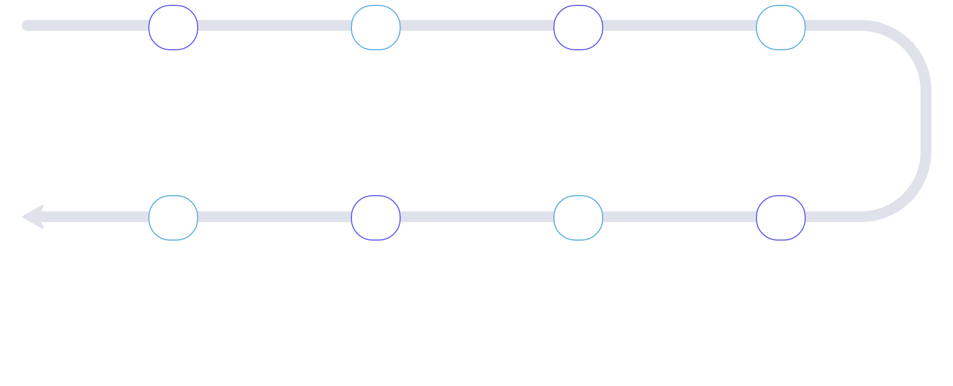
One-way data extraction mode hinders sustainable value cycle
01
02
03
04
One-way data collection
value monopoly
Lack of feedback mechanism
Inadequate incentive design
The platform unilaterally collects user data without two-way interaction. Users cannot control the destination of their data. The data acquisition method exhibits monopolistic characteristics.
The platform retains all data-derived value. User contributions are not fairly distributed. The profit-sharing mechanism is severely lacking.
No follow-up response to user behavior. Lack of feedback channels. This leads to a continuous decline in engagement.
No rewards for user contributions. Its hard to keep users engaged. Users motivation is fading.
08
07
06
05
System ecosystem imbalance
insufficient motivation to participate
Value cannot be returned.
data loop closure
The platform and users are not on equal footing. The partnership has broken down. The entire system is difficult to sustain long-term.
Users lack the willingness to contribute continuously, and their engagement decreases, which affects both the quality and quantity of data.
The value created by users is not being returned. Contributions are not being rewarded proportionally. This undermines the sustainability of the ecosystem.
Data is only shared within the platform and cannot be shared externally, creating an information silo effect.

Slide 10
03
Solution

Slide 11
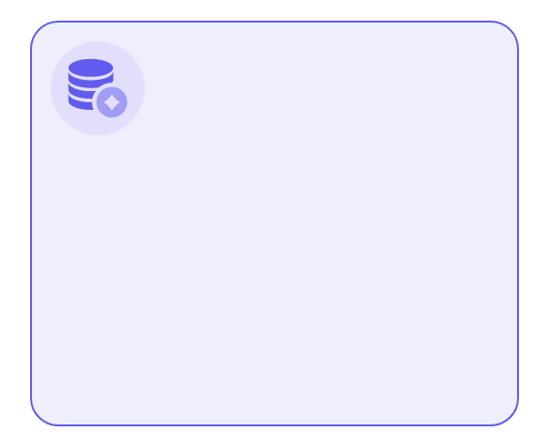


The DataWave protocol enables data assetization, instant payments, and perpetual dividends.
Data Assetization
pay down
Dividends Forever
The DataWave protocol enables users to claim ownership of their generated data and convert it into tradable assets on the blockchain, unlocking the economic value of data.
The Sui Chain enables millisecond-level transaction confirmation, allowing users to instantly receive SUI rewards upon data creation, thereby boosting engagement.
The smart contract dividend mechanism activates automatically when data is subscribed, providing users with a long-term, sustainable passive income stream.

Slide 12
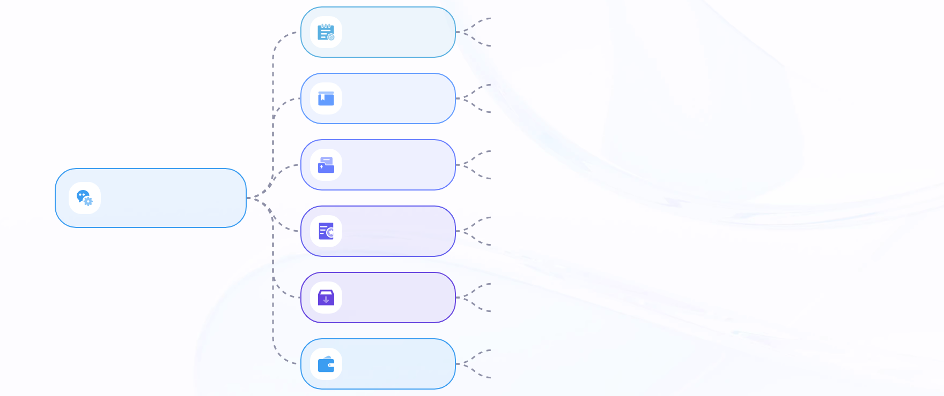
The hub-and-spoke architecture connects storage, on-chain economy, and privacy protection
As the central hub, the DataWave Protocol coordinates the data assetization process.
unified scheduling
Unified management of payment and revenue distribution to improve the overall efficiency of the system.
Implement permanent storage with Walrus to ensure long-term data accessibility.
decentralized storage
Ensure data immutability and enhance the credibility of on-chain information.
The Sui blockchain enables high throughput and low latency for transactions.
Instant Value Stream
Smart contracts automatically execute payments to ensure transparent and accurate profit distribution.
Data economy system
Integrate Seal technology to encrypt sensitive data and prevent unauthorized access.
privacy protection
Supports selective disclosure of information, giving users control over data sharing.
On-chain evidence enables traceability of data sources and changes.
Data is verifiable
Use cryptographic mechanisms to verify data integrity and prevent forgery and tampering.
Build an end-to-end security architecture to defend against external attacks and internal abuse.
Safe and efficient
The optimization protocol layer collaboration to achieve a balance between high performance and low energy consumption.

Slide 13




Users get long-term revenue through authorized subscriptions
Authorization means revenue
Dividend stream
Transparent and verifiable
ecological co-incentive
After the user authorizes data usage, the subscription and profit-sharing mechanism will automatically activate, generating revenue with each visit.
Continuous revenue sharing based on smart contracts ensures that users receive passive income over the long term.
All subscription records and dividend details are publicly available on the blockchain, allowing users to verify their income sources at any time.
95% of the revenue flows back to the data producers and contributors, creating a sustainable value cycle.

Slide 14
04
Technical architecture

Slide 15
Three-tier architecture: The Seal privacy layer ensures selective data disclosure
privacy protection
Value distribution
Permanent storage
The Seal layer enables selective disclosure, ensuring users share only necessary data and protecting privacy.
The Sui blockchain executes smart contracts to efficiently handle automatic profit distribution and asset ownership confirmation.
Walrus provides decentralized permanent storage, ensuring data immutability and long-term accessibility.

Slide 16

The Sui economic layer enables efficient value distribution and smart contract execution
01
02
03
04
Sui economic layer
Move language contract
high throughput advantage
Low transaction costs
Build an economic system based on Sui blockchain to enable efficient value transfer. This architecture fully leverages Suis high-performance features to provide foundational support for decentralized applications.
Use Move to write smart contracts for logical security and trusted execution. Implement automated data revenue distribution. Improve code verifiability and asset security.
The system supports processing thousands of transactions per second, effectively handling large-scale user concurrency. It ensures application response speed and network stability.
With a single Gas fee as low as 0.002 SUI, it significantly reduces user operational costs, facilitates high-frequency small-amount transactions, and boosts ecosystem engagement.
05
06
Automatic earnings distribution
Instant payment experience
Automate revenue distribution through smart contracts. Reduce human intervention and trust costs. Improve distribution transparency and execution efficiency.
Instant settlement is enabled after user authorization. This significantly improves fund flow efficiency and optimizes overall user experience and liquidity management.

Slide 17



The Walrus storage layer provides permanent, decentralized, and low-cost data storage solutions.
Permanent storage
decentration
Walrus ensures that data, once written, cannot be deleted, achieving true permanent storage.
Data is stored in a distributed manner, eliminating reliance on a single node to ensure censorship resistance and high availability.
low cost
Compared with traditional solutions, the storage cost is reduced by 90% and supports large-scale data on the chain.

Slide 18
05
User experience path

Slide 19

Users who create data will receive an instant UI reward to encourage participation.
Auto-trigger rewards
Low-threshold participation
The system automatically triggers reward distribution after data upload, eliminating manual intervention and enhancing user experience.
The project has no high requirements. You can upload data after registration, which lowers the entry barrier for users.
On-chain transparent and verifiable
Create a reward
All rewards are recorded on the blockchain in a transparent way, and transactions are confirmed within 2 seconds, enhancing trust and security.
Users earn 0.5 SUI rewards for each valid data entry, delivering a direct and efficient incentive.

Slide 20
Allow third-party access and enable subscription revenue stream
01
02
03
04
authorization is revenue
Flexible subscription
automatic dividend mechanism
current cash flow
Grant access to your data to activate your subscription revenue stream and unlock value.
Set subscription rules by time, frequency, or purpose to meet diverse data usage scenarios.
Smart contracts automatically distribute profits, ensuring transparency, trustworthiness, and eliminating the need for intermediaries.
Payment is triggered every time the data is called, providing users with predictable long-term passive income.

Slide 21
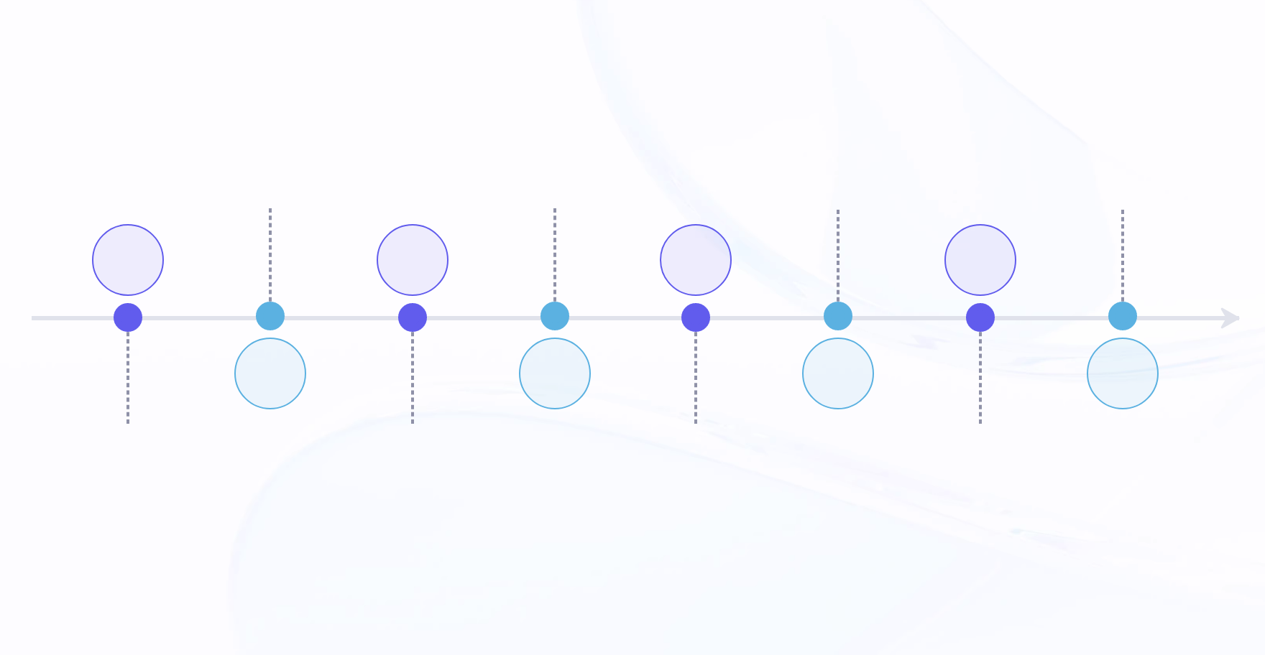
Consistently receive dividends, generating predictable passive income
Participate in profit sharing
Passive income
Each data call triggers a revenue share. Users receive a percentage of the revenue as a UI reward. The revenue is automatically distributed without human intervention.
SUI reward distribution
Subscription revenue pool
Users enjoy stable long-term earnings. Revenue increases with data call frequency. Rewards accumulate without additional actions.
Rewards are distributed in real time as UI tokens. They are allocated to data providers at a preset ratio. Tokens can be freely circulated or staked.
Gather data call revenue to form a shared pool. Users data contributions determine their revenue shares. Achieve decentralized value rewards.
01
03
05
07
02
04
06
08
Authorize data usage
on-chain dividend mechanism
Smart Contract Protection
Transparent Recording
The user agrees to use their data for the subscription revenue pool. After authorization, the data can participate in the on-chain profit-sharing mechanism. The data usage rights are governed by smart contracts.
All dividend records are stored on the blockchain. Ensure the process is open and transparent. Dividends are distributed instantly and traceable.
The allocation rules are locked by the contract code to prevent tampering or interference, ensuring fairness and security.
All transactions and dividends are verifiable on the blockchain. This enhances trust and auditability. Anyone can verify the allocation results.

Slide 22
06
Product Demo

Slide 23



Mobile transactions are processed in real time: 0.5 SUI, confirmation in <2 seconds
Instant
Low cost, high efficiency
Smooth operation
Users receive a 0.5 SUI reward immediately after submitting data, with on-chain confirmation in under 2 seconds for a seamless incentive experience.
Each transaction consumes only 0.002 SUI Gas, ensuring the economic viability of high-frequency operations.
The mobile interface is simple and intuitive, and the whole process from creation to payment is automated, without complex interaction.

Slide 24



On-chain transactions are verifiable: the code automatically executes the revenue distribution logic
Transactions are transparent and verifiable.
Automatically execute code
Open source core logic
All dividend transactions are recorded on the Sui chain and publicly verified by Explorer, ensuring the process is tamper-proof.
Smart contracts automatically distribute rewards based on predefined rules, eliminating human intervention to ensure fairness and real-time execution.
The Key Move code snippet is published to demonstrate the deterministic execution mechanism for revenue calculation and transfer.

Slide 25
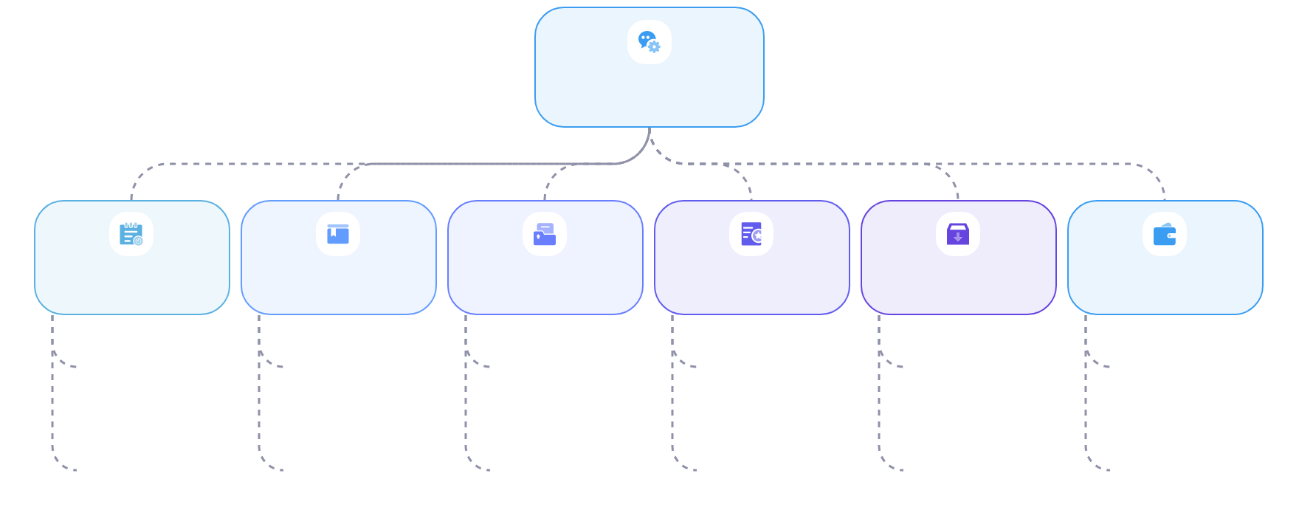
Walrus has generated a permanent Blob ID for public verification
Data Storage
unique identification
Non-tamperable
Permanent storage
decentration
high availability
Public verification
Upload to generate a Blob ID to ensure each data record is traceable.
Once uploaded, the data cannot be modified or deleted.
Permanently store data using the Walrus mechanism.
Distributed network storage eliminates the risk of single point failure.
Multiple node redundancy ensures continuous service availability.
Anyone can verify the existence of data using the Blob ID.
The Blob ID is globally unique to prevent duplicate or forged data.
Hash verification ensures data integrity and prevents malicious tampering.
No renewal required, avoiding the expiration and loss risk of traditional storage.
The nodes are widely distributed to improve the anti-censorship capability of the system.
The network has strong self-healing capabilities and supports resuming transmission and recovery from breakpoints.
Supports independent integrity verification to enhance trust transparency.

Slide 26



Subscribe to show the revenue distribution pie chart and real-time data
income distribution
Dynamic visualization
Transparent and verifiable
Subscription revenue is automatically distributed as follows: 67.5% to data creators, 27.5% to survey initiators, and 5% to platform maintenance.
Interactive pie chart with real-time updates. Hover to view specific amounts, clearly showing revenue flow and distribution details.
All transactions are recorded on the chain, so users can verify the source of dividends and ensure that the rules of distribution are open, fair and unalterable.

Slide 27
07
Business model

Slide 28




95% of subscription revenue flows back to the ecosystem, creating a sustainable incentive mechanism
disposition of income
Ecological Incentives
Platform role
value loop
95% of subscription revenue is automatically distributed through smart contracts, with the remainder flowing directly to ecosystem participants.
High rate of return will encourage data creators to continue contributing high-quality data resources.
Only 5% of the platform is reserved for system maintenance to ensure decentralization and long-term operation.
Efficient capital circulation enhances ecological cohesion, forming a sustainable closed loop in the data economy.

Slide 29
Smart contracts automate allocation, reducing human intervention risks
Auto split
Rules are transparent
rea time executive
Decentralized Governance
All subscription revenue is automatically distributed through smart contracts, no manual operation required.
The logical allocation is publicly disclosed on the chain, with immutable and verifiable proportions for all parties.
Earns are processed in real time to ensure data contributors receive their rewards promptly.
The platform only charges 5% maintenance fees, with full transparency and auditability of fund flows.

Slide 30



Only 5% of the platform is reserved for maintenance to ensure decentralized governance
minimal extraction
Auto-assign
Decentralized Governance
The platform charges only 5% to maximize value for users and ecosystem participants.
Smart contracts transparently distribute the proceeds without human intervention, ensuring fairness.
The low-commission mechanism supports long-term autonomy and promotes the evolution of the protocol to a community-managed model.

Slide 31
08
Developing route

Slide 32
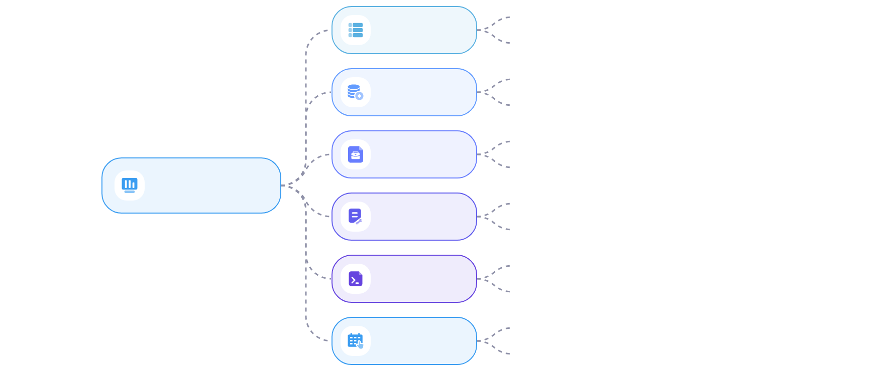
Complete the implementation of the research data scenario by 2026 to verify the models feasibility
Users earn revenue by creating content, encouraging active data contribution.
User Incentives
Behavioral data validation model to ensure the sustainability of the incentive mechanism.
Verify system stability based on real behavior tests.
economic model
Adjust parameters dynamically to optimize resource allocation efficiency.
Connect with the first batch of demand-side entities to establish a supply-demand matching channel.
data market
Promote the subscription model to establish a stable transaction mechanism.
data loop
Promote data circulation and enhance the value of resource utilization.
ecological activation
Multiple parties participate in the coordination to enhance the network effect of the system.
The first closed loop was successfully completed, validating the business models viability.
Scenario implementation
Real environment testing, accumulate key operational experience.
Evaluate model accuracy using user behavior data.
data validation
Monitor feedback continuously to optimize system response.

Slide 33
09
Competitive edge

Slide 34
The only full-stack data protocol that supports instant payment and perpetual revenue
01
02
03
pay down
perpetual income
full stack integration
Transactions are confirmed within 2 seconds on the Sui Chain, with users receiving SUI rewards instantly upon data creation.
Through the subscription dividend mechanism, the data authorization will continue to generate passive income, and the long-term value can be expected.
Seamlessly integrating Seal privacy, Sui economy, and Walrus storage, it delivers comprehensive functionality and efficient collaboration.

Slide 35


Compared to Ocean and Filecoin, it demonstrates significant advantages in both gas cost efficiency and functional completeness.
Instant payment support
sustainable income mechanism
Gas cost advantage
The only protocol enabling real-time data transaction settlement, allowing users to earn SUI rewards within seconds.
By subscribing to the dividend model, creators can sustain long-term passive income.
With a single transaction cost of just 0.002 SUI, this significantly outperforms competitors and enables large-scale implementation.

Slide 36




Sui and Walrus are deeply integrated, natively supporting high performance and permanent storage.
Native performance advantage
Permanent storage guarantee
Low-cost operation
Full-stack collaborative design
The Sui object model enables high-concurrency processing, with TPS exceeding 1000 and transaction confirmation under 2 seconds.
Deeply integrated with Walrus, data is immutable upon writing and automatically retains permanent storage without renewal.
Gas costs as low as 0.002 SUI, with storage costs 60% lower than IPFS, increasing user revenue potential.
The protocol layer is natively aligned with the underlying technology stack, ensuring efficient synergy among privacy, cost-effectiveness, and storage.

Slide 37
10
Future expectations

Slide 38

DataWave is not just a hackathon project, but also the starting point of infrastructure development.
project positioning
Core Goal
Data sovereignty
Value flow
The hackathon prototype has been upgraded to a Web3 data economy underlying protocol designed to support decentralized data circulation, featuring scalability and versatility.
Build an open data asset circulation network that connects creators, consumers, and developers. Promote the return of data sovereignty to individuals.
Emphasize individuals control over their own data. Break the data monopoly of centralized platforms. Enable users to manage their data autonomously.
Enable free data trading in decentralized markets. Ensure data value is not withheld by intermediaries. Connect producers and consumers directly.
Ecological connectivity
Protocol Features
canon of economy
Future Vision
Create a collaborative path for creators and developers. Provide consumers with trusted data sources. Create a data economy ecosystem that benefits all parties.
Highly scalable and adaptable to various scenarios. Supports universal access to reduce usage barriers. Ensures long-term stable system operation.
Reconstruct the profit distribution mechanism of digital economy. Ensure that data contributors get reasonable returns. Establish a fair and transparent value exchange system.
Promote the sharing of data value by all. Build a decentralized digital society. Achieve data-driven equitable economic growth.

Slide 39
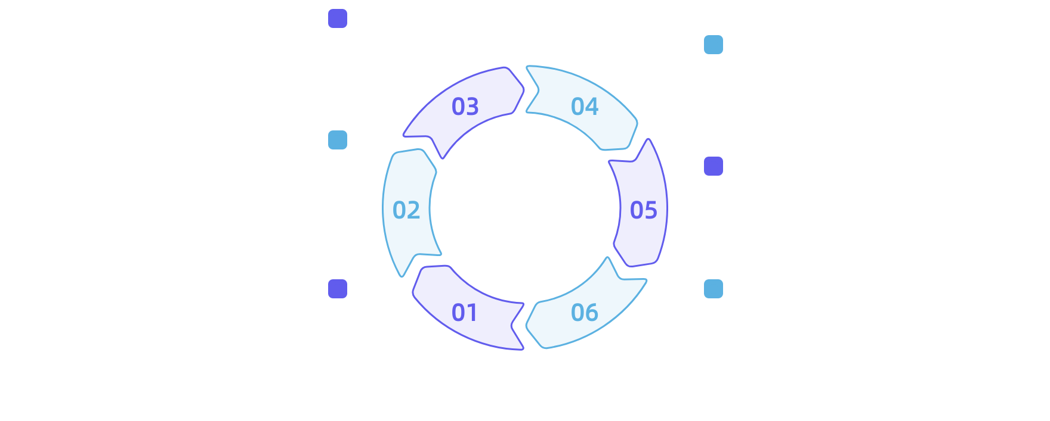
Make everyones data a truly productive digital asset
Subscription model
Users can earn ongoing income by authorizing others to use their data. The subscription mechanism ensures long-term return stability. It enhances individual voice in data transactions.
Passive income formation
Continuous data usage generates a steady income stream. You can earn returns without active participation. It helps individuals accumulate data wealth.
Tokenization
Transform personal data into quantifiable digital tokens with financial attributes. These tokens can be traded within a compliant framework, thereby enhancing data liquidity and economic value.
Break the monopoly of the platform
Reduce the centralized platforms exclusive control over data. Users hold the rights to use and distribute data. Promote a fair market competition environment.
On-chain Ownership
Inclusive data economy
Use blockchain technology to confirm personal data ownership and ensure clear data attribution. Each users data rights are recorded and protected in an immutable manner, laying the foundation for data assetization.
Promote equal participation of all individuals in data value distribution. Share the economic benefits of the data economy. Realize the vision of data as assets in society.

Slide 40




Jointly building an open, fair and sustainable Web3 data economy
Open Ecology
Fair distribution
continuous incentive
Global collaboration
Through open source licenses and open standards, we welcome developers to co-create data applications and foster an thriving ecosystem.
Ensure data value is created by its creators, with transparent and predictable returns, and break platform monopolies.
The perpetual dividend mechanism encourages long-term participation, forming a positive cycle in the data economy network.
In collaboration with partners like Sui and Walrus, we are building a decentralized infrastructure to serve users worldwide.

Slide 41
THANKS

